Slide 1

grove
Cultivate your post-grad community
After graduating college, you're suddenly faced with the challenge of building friendships amidst a sea of new connections. The confidence, planning, and commitment required to be successful at this can be a source of stress for many. Grove removes the pressure by assisting with the inviting, planning, and follow-up in a low-stakes way so that you can enjoy watching your community grow.
Team 2, Easing Life Transitions: Amelia, Chris, Jasmine and Tiff

Slide 2


Market Research (1/3)
Bumble BFF
Facebook Groups
Description. Dating app for friends; users swipe left if they don’t like an individual, and swipe right if they resonate with their profile in hopes of being “matched”. Among matches, conversations and planning of activities are self-guided.
Insights. Attributes you look for in a friend are different than for a partner, so developing an enticing “friend” profile proved difficult for users.
Uniqueness. Grove focuses on the deepening of friendships and provides structural support for friendship over time, rather than just creating initial connections based on shared interests.
Description. Users opt-in to groups created based on shared interests. Anyone in the group can initiate conversations or planning of events surrounding interest of group.
Insights. Facebook Groups can be overwhelming due to their size–hard to form meaningful connections with individuals in the group.
Uniqueness. Grove focuses on fostering one-on-one relationships, rather than forming affinity groups or advertising community events.
Notes:
how their solutions differ from yours, what has (or has not) worked for them, and what makes your solution concept unique.

Slide 3


Market Research (2/3)
Meetup
Garden
Description. Join established groups based on shared interests; find group events happening near you; create groups based on your own interests.
Insights. Best for users that are interested in large group activities and expanding their social circles; relies on individuals in groups to take initiative and plan successful group events.
Unique. Grove focuses on depth of individual relationships rather than breadth of connections; suggests events for users and provides structure to deepen friendships.
Description. Maintain personal relationships by setting frequency of reminders to reach out to individuals in your contacts.
Insights. Relies on users already having deep relationships; addressing issue of becoming distanced from one’s close relationships.
Unique. Grove does not not rely on users already having deep relationships; helps users deepen new friendships with people they just met; addressing different problem of not having deep friendships to begin with.

Slide 4


Market Research (3/3)
hang
Prim
Description. Users post an activity they want to do and nearby users can join.
Insights. Does not focus on retention of friendship and building strong 1:1 relationships. Purpose is to find someone to do a particular activity with at the moment.
Unique. Grove helps users focus on developing deep friendships and progressively more varied and personal activities with time.
Description. Helps you stay connected with family, friends and colleagues by scheduling reminders to follow up with friends and visualize interactions over time.
Insights. Focuses on retaining existing strong connections; reminds one user to maintain their connections and keep in touch.
Unique. Grove includes both parties in building the friendship together, and is designed to focus on building stronger friendships with individuals you’ve just met.

Slide 5
Tasks
01
02
03
04
O7
05
06
Recall/view past hangouts.
Simple
Schedule an activity that works for both you and another person you want to get to know better. Simple
Capture the memory of hangout. Simple
Report on successfulness of a hangout. Simple
Plan and follow through on continuous and varied hangouts with people who had a successful initial connection. Complex
Communicate with people you want to get to know more deeply regularly.
Medium
Reflect on and plan intentional cadence of future communication. Medium
*Bold indicates tasks we targeted in our concept video.
Notes:
Bold indicates reflected in our video

Slide 6
Values in Design
Consistency
Respect
Potential Conflicts
Authenticity
Intentionality
Privacy
Healthy Use of
Technology
Embed consistency in following up on new friendships.
Respect new acquaintances and friends through meaningful contact and planning.
Consistency vs Respect
Some users may seek a stronger friendship with another user that is not reciprocated. Build in customization for preferences and boundaries for both users.
Consistency vs Healthy Use of Technology
Frequent use of the app may conflict with the goal of a healthy lack of reliance on technology. Help users plan in-person interactions if both are comfortable.
Be yourself as you enter a friendship and do activities that you will likely enjoy.
Reflect on and actively plan how you want to build a friendship.
Being mindful of user data stored in the app and shared with others. Being clear on what data is being shared with friends.
Use technology to empower friendships but not be the sole form of interaction between each other.
Notes:
Include a statement about the values embedded in the project and how you intend to encode these values. ○ Are there conflicting values? ○ If so, how are you addressing such conflicts?

Slide 7

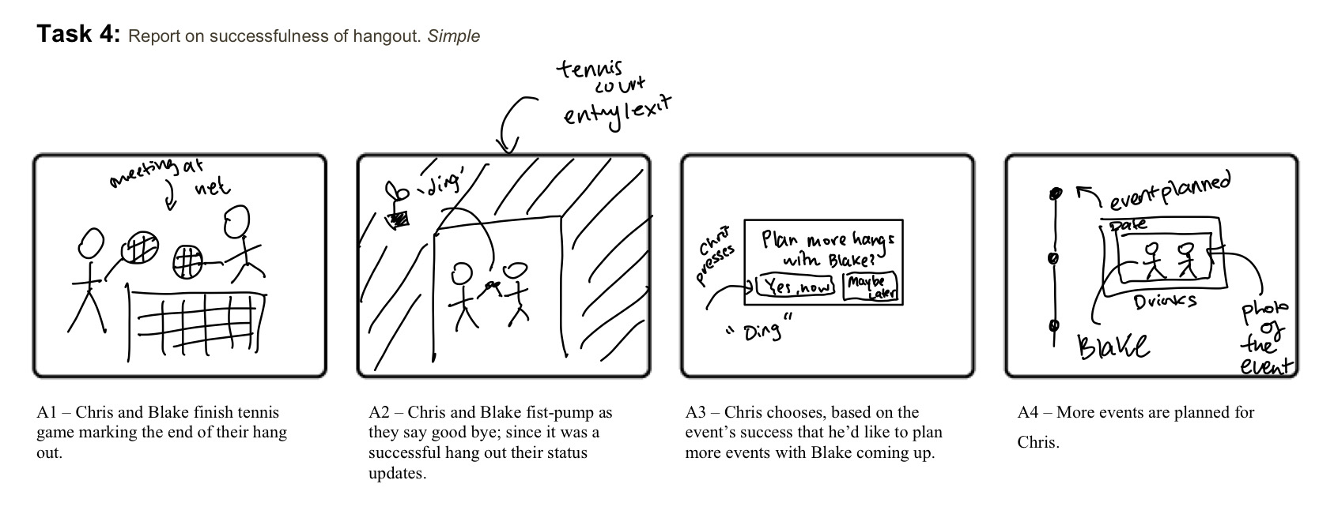
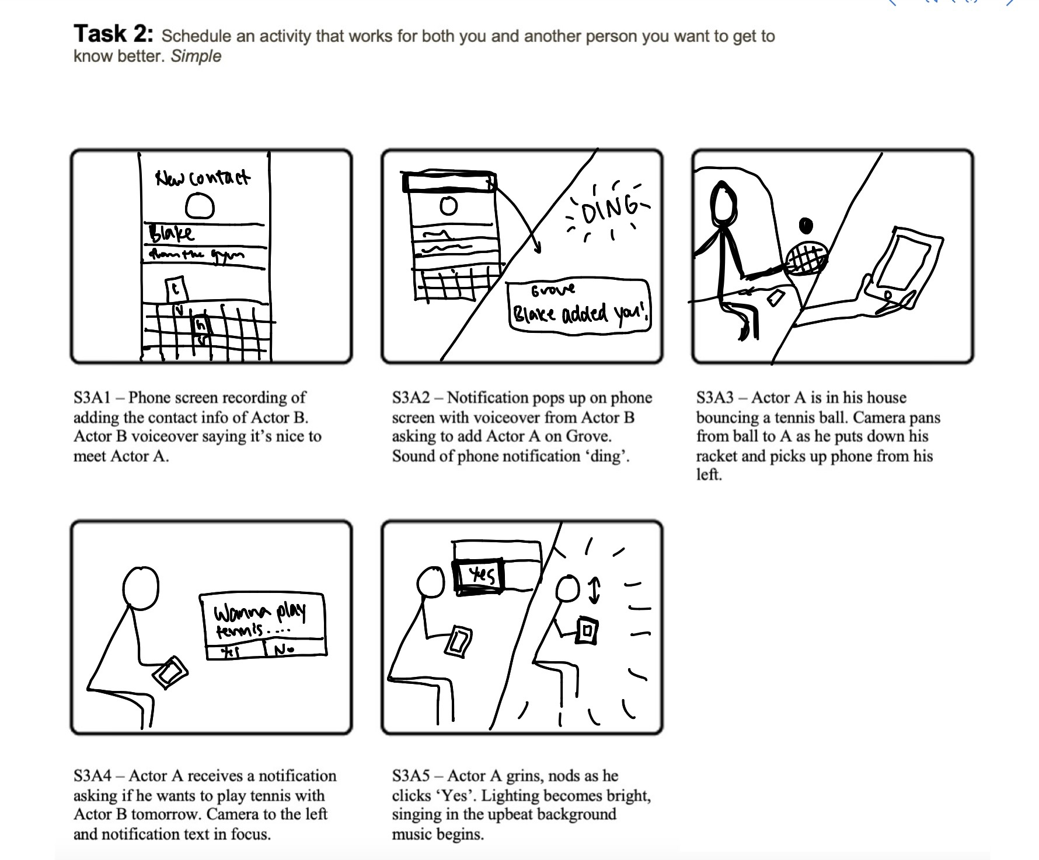
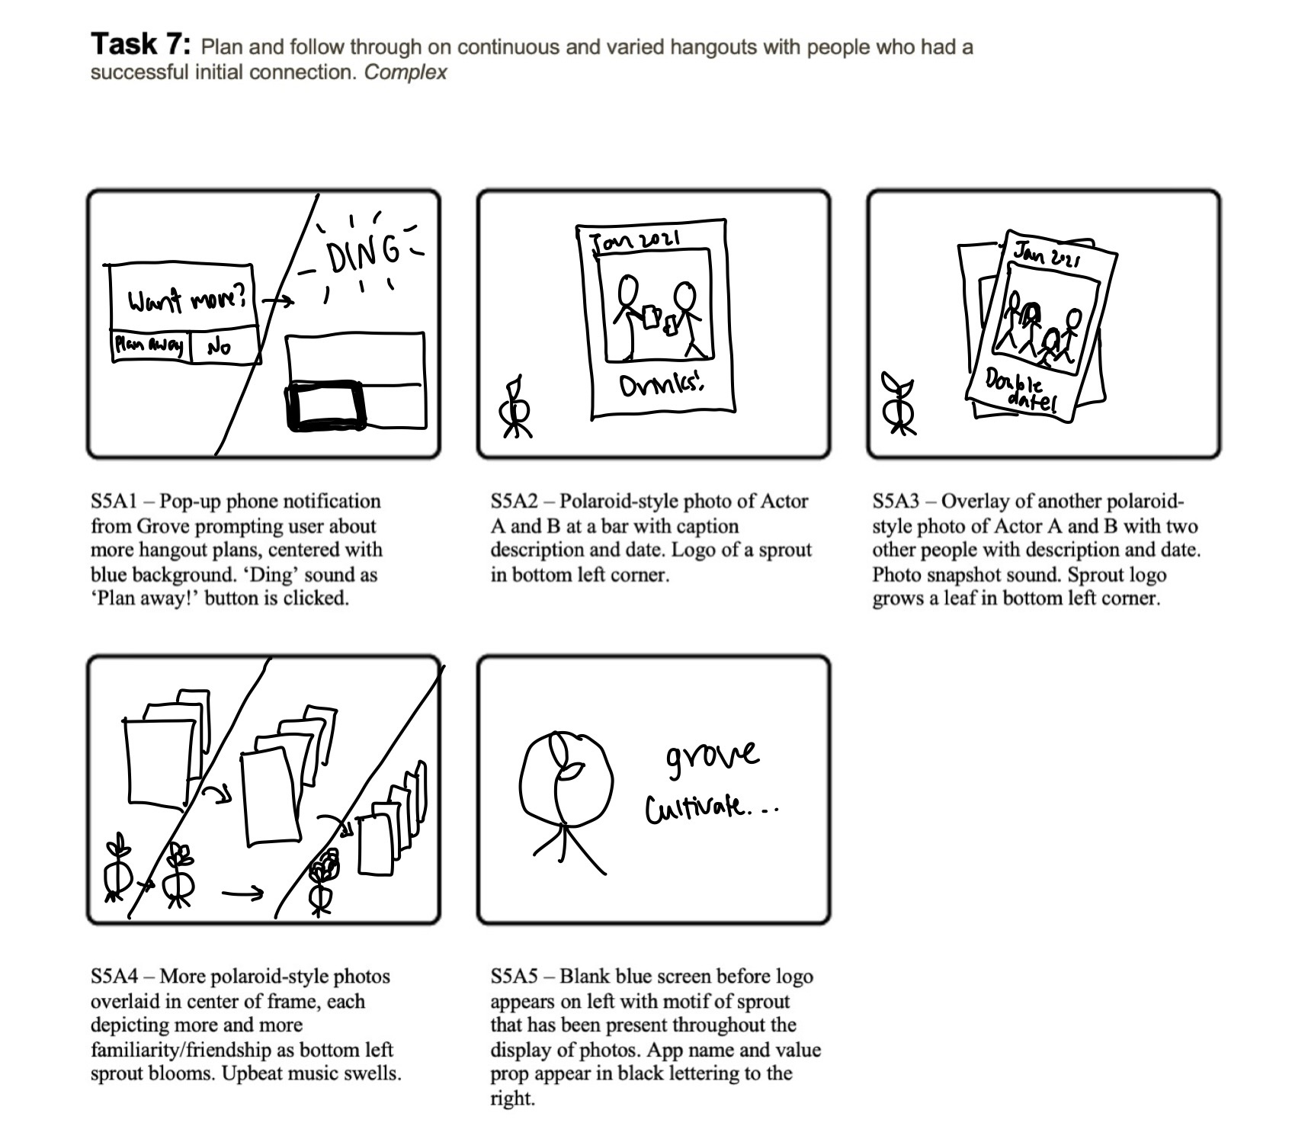
Video Storyboard

